Slide 1
Predicting Breast Cancer - Logistic Regression
VINOLIA VARSHA
Phone : 7022153930
Email : svinoliyavarsha97@gmail.com

Slide 2
Dataset
breast cancer
Dataset link :
https://www.kaggle.com/datasets/shankarat/breast-cancer/download

Slide 3
About Data Attribute Information
id
diagnosis: M = malignant, B = benign
Columns 3 to 32

Slide 4
Ten real-valued features are computed for each cell nucleus:
radius: distances from center to points on the perimeter
texture: standard deviation of gray-scale values
perimeter
area
smoothness: local variation in radius lengths
compactness: perimeter^2 / area - 1.0
concavity: severity of concave portions of the contour
concave points: number of concave portions of the contour
symmetry
fractal dimension: "coastline approximation" - 1 The mean, standard error, and "worst" or largest (mean of the three largest values) of these features were computed for each image, resulting in 30 features. For instance, field 3 is Mean Radius, field 13 is Radius SE, field 23 is Worst Radius.

Slide 5
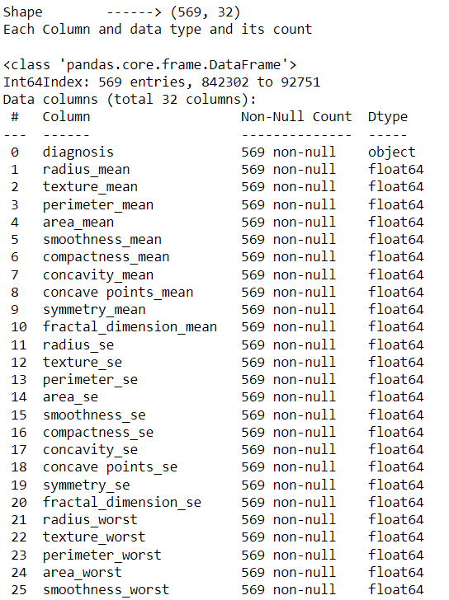
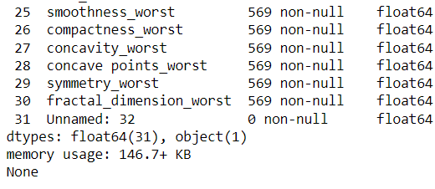
Each Column and data type and its count
Shape ------> (569, 32)

Slide 6
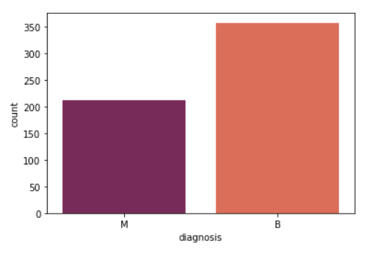
MAJOR FINDINGS THROUGH EDA
Validate each class to understand if the dataset is imbalanced.
Total Belign Tumor (B) : 357 and its percentage is 62.74 %
Total Malignant Tumor (M) : 212 and its percentage is 37.26 %
Diagnosis is a label column and has 2 classes 'M' (Malignant) and 'B' (Belign) tumor.

Slide 7
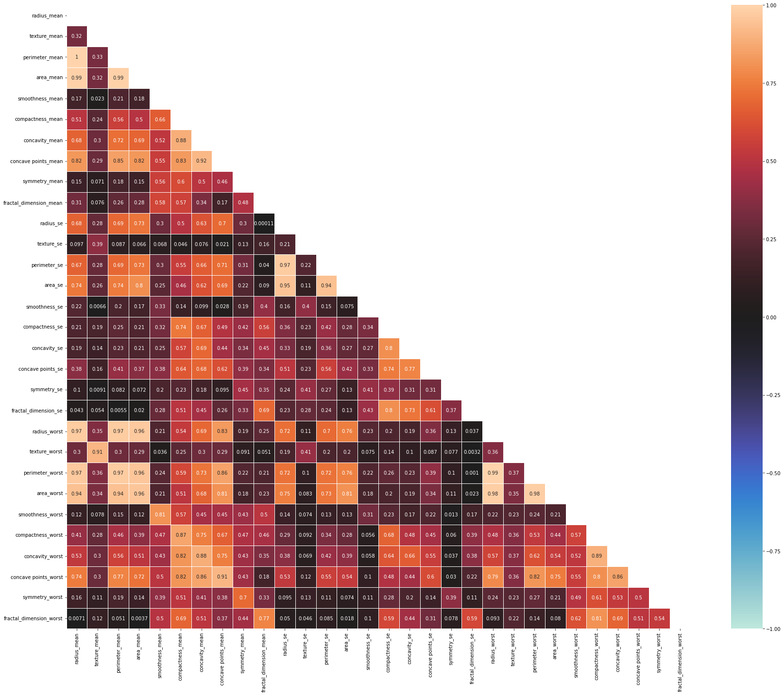
heatmap to visualize and find the coefficient of multicollinearity.
Correlation matrix Shape = (30, 30)

Slide 8
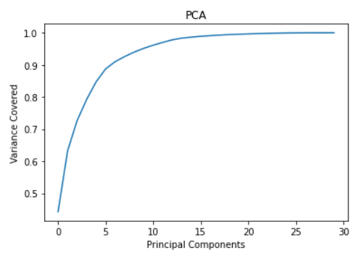
collinearity
PCA to pick top components which can explain maximum variance and later we use same components for training and testing.
Let's figure out the right number of components by plotting explained_variance_ratio_
Around 13 Principal Components are able to explain > 95 % variance. It's safe to pick starting 13 PC’s.

Slide 9
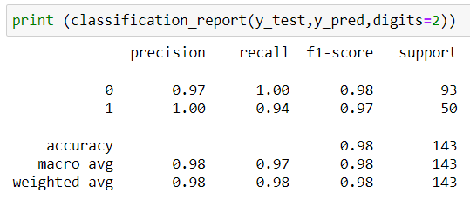
Model Buidling and prediction
Generate Classification report to find Precision , Recall and F1 score

Slide 10
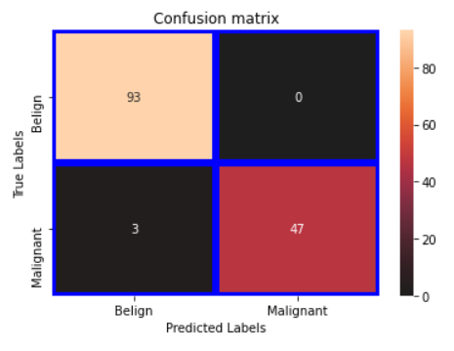
generating confusion matrix
True Positive > 93
False Positive > 0
False Negetive > 3
True Negetive > 47

Slide 11
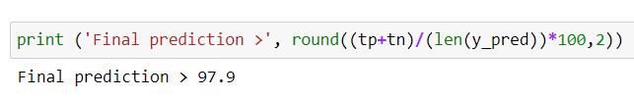
Final prediction
Our model is able to predict with 97.9% accuracy of the test data

Slide 12
Thank you
HAPPY LEARING

